Slide 1
K means Clustering Algorithm Explained With an Example

Slide 2
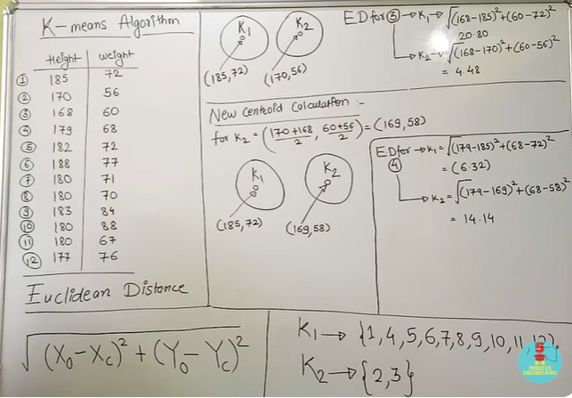
K means Clustering Algorithm Explained With an Example Easiest And Quickest Way Ever
7.21

Slide 3
https://www.youtube.com/watch?v=CLKW6uWJtTc

Slide 4
K-means clustering with k=3 (same previous example)
Data are
(185,72), (170,56), (168,60), (179,68), (182,72),
(188,77), (180,71), (180,70), (183,84), (180,88),
(180,67), (177,76)

Slide 5
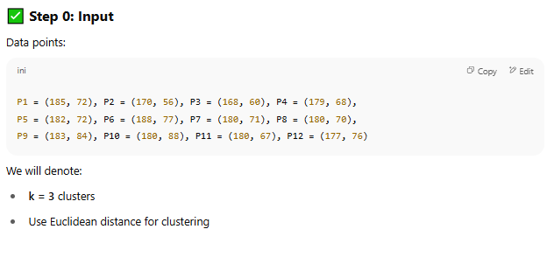
K-means clustering with k=3 (same previous example)

Slide 6
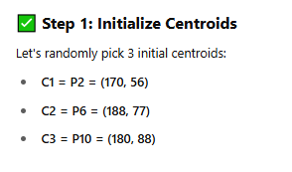
K-means clustering with k=3 (same previous example)

Slide 7
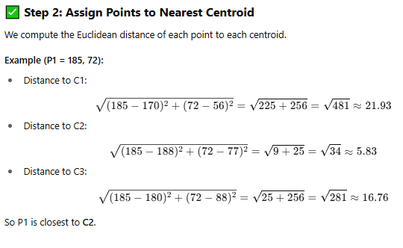
K-means clustering with k=3 (same previous example)

Slide 8
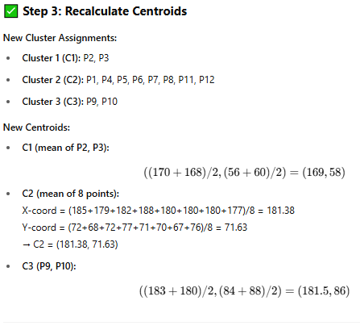
K-means clustering with k=3 (same previous example)
Distance Table (Approximated)
Point | C1 (170,56) | C2 (188,77) | C3 (180,88) | Cluster
P1 (185,72) | 21.93 | 5.83 | 16.76 | C2
P2 (170,56) | 0 | 29.83 | 36.80 | C1
P3 (168,60) | 4.47 | 30.81 | 35.44 | C1
P4 (179,68) | 13.60 | 11.31 | 20.10 | C2
P5 (182,72) | 18.87 | 6.71 | 16.28 | C2
P6 (188,77) | 29.83 | 0 | 15.13 | C2
P7 (180,71) | 17.03 | 9.49 | 17.00 | C2
P8 (180,70) | 16.12 | 10.20 | 18.03 | C2
P9 (183,84) | 33.88 | 7.28 | 5.00 | C3
P10 (180,88) | 36.80 | 15.13 | 0 | C3
P11 (180,67) | 14.87 | 12.04 | 21.47 | C2
P12 (177,76) | 21.63 | 11.18 | 13.00 | C2

Slide 9
K-means clustering with k=3 (same previous example)
Step 4: Reassign Points
Repeat distance calculation with updated centroids (169,58), (181.38,71.63), and (181.5,86).
Most points will likely stay in the same cluster—repeat until centroids don't change significantly.

Slide 10
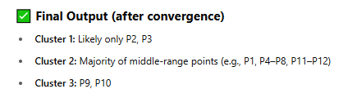
K-means clustering with k=3 (same previous example)

Slide 11
K-Nearest Neighbor Classification ll KNN Classification Explained with Solved Example

Slide 12
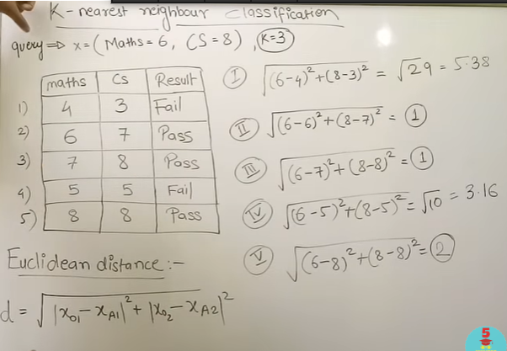
K-Nearest Neighbor Classification ll KNN Classification Explained with Solved Example

Slide 13
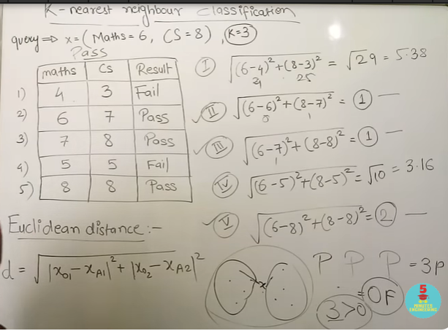
K-Nearest Neighbor Classification ll KNN Classification Explained with Solved Example

Slide 14
https://www.youtube.com/watch?v=CJjSPCslxqQ

